Slide 1

Facial Recognition Lock
John Joey Wright
20105823

Slide 2
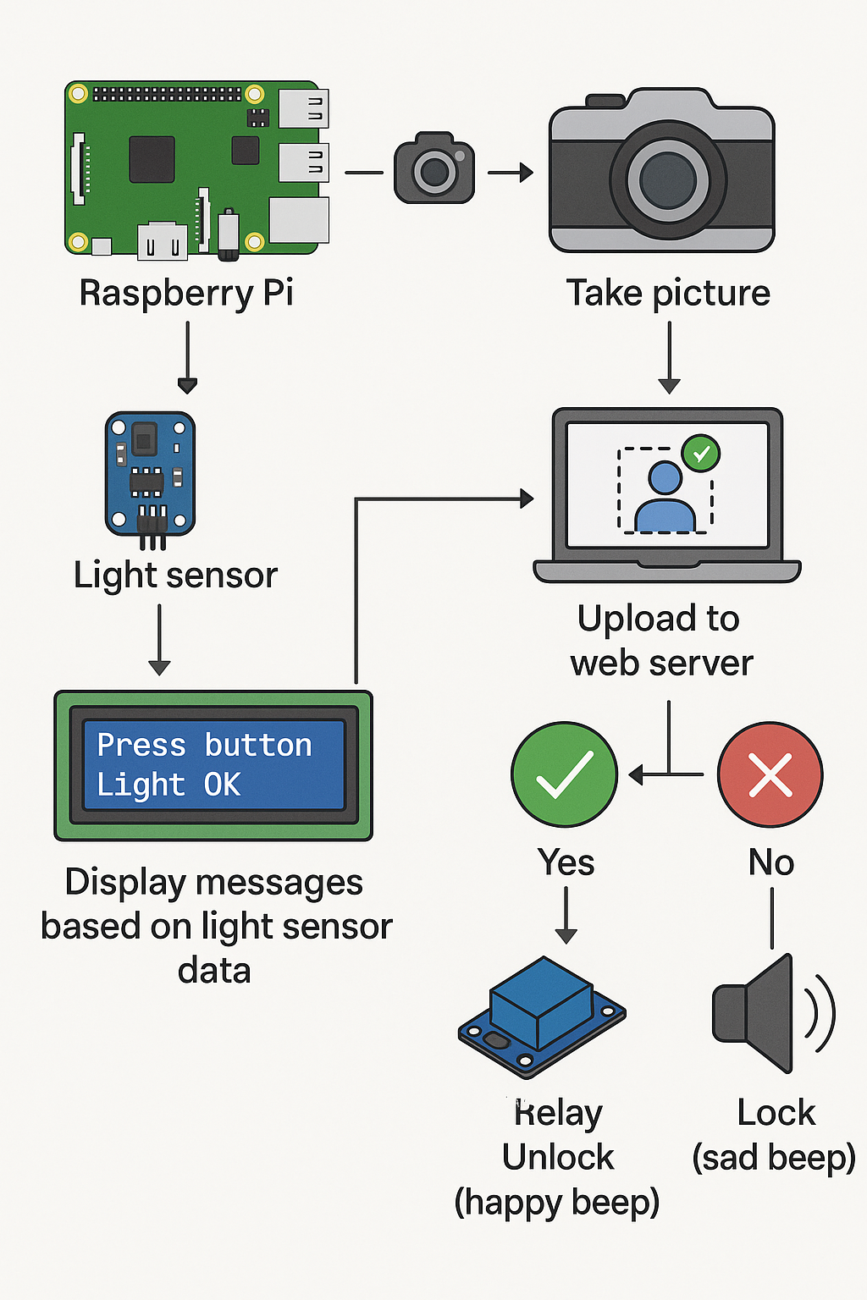
How it works!
The Raspberry pi takes a picture after the button is pressed and uploads it to a web app container that hosts the facial recognition verification process.
When it comes back either verified/unknown it reacts by turning on the relay and giving a different beeps.

Slide 3
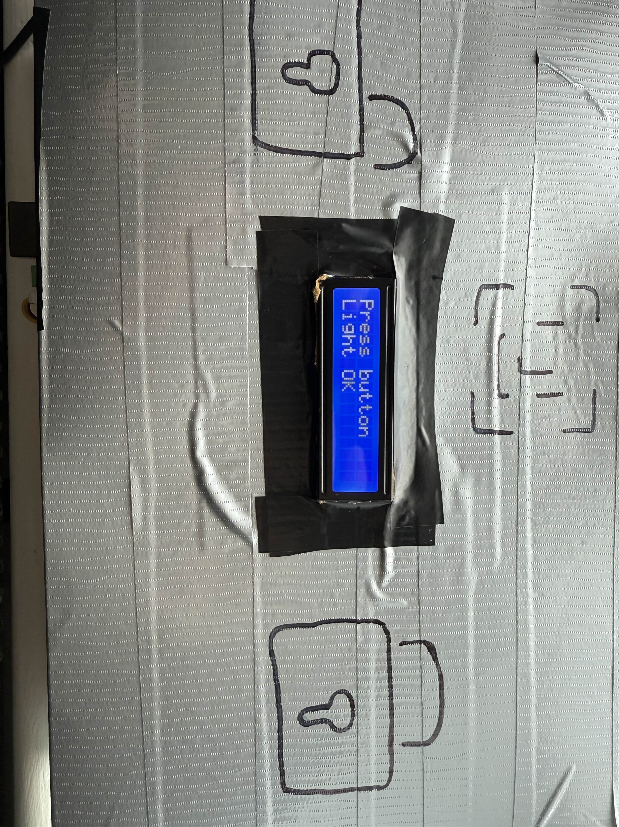
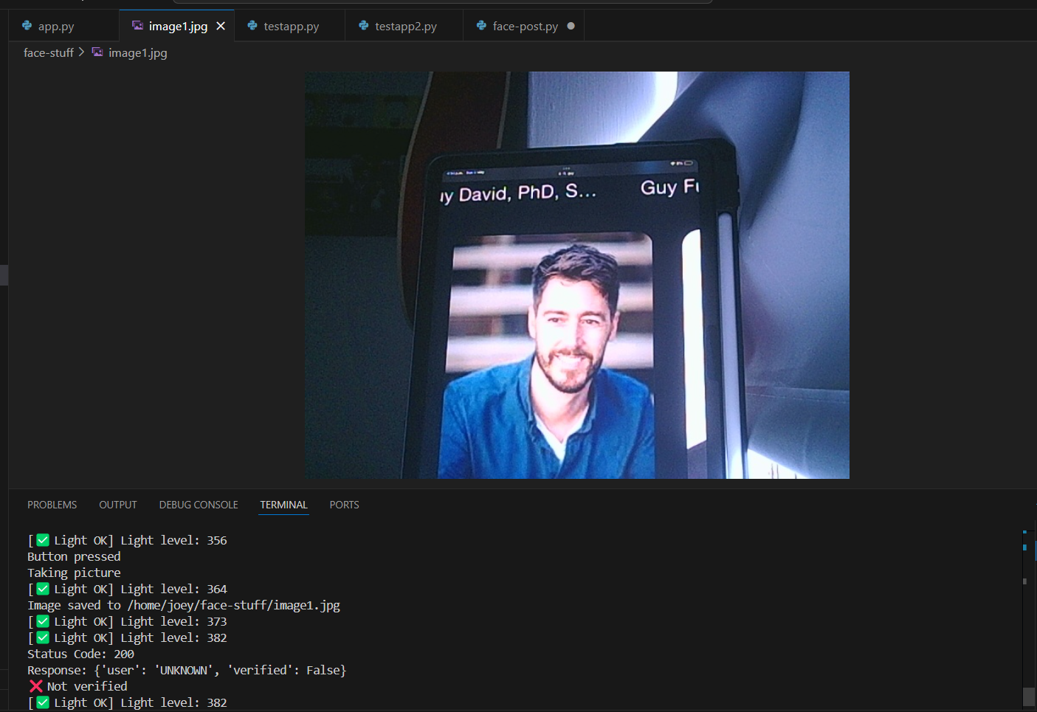
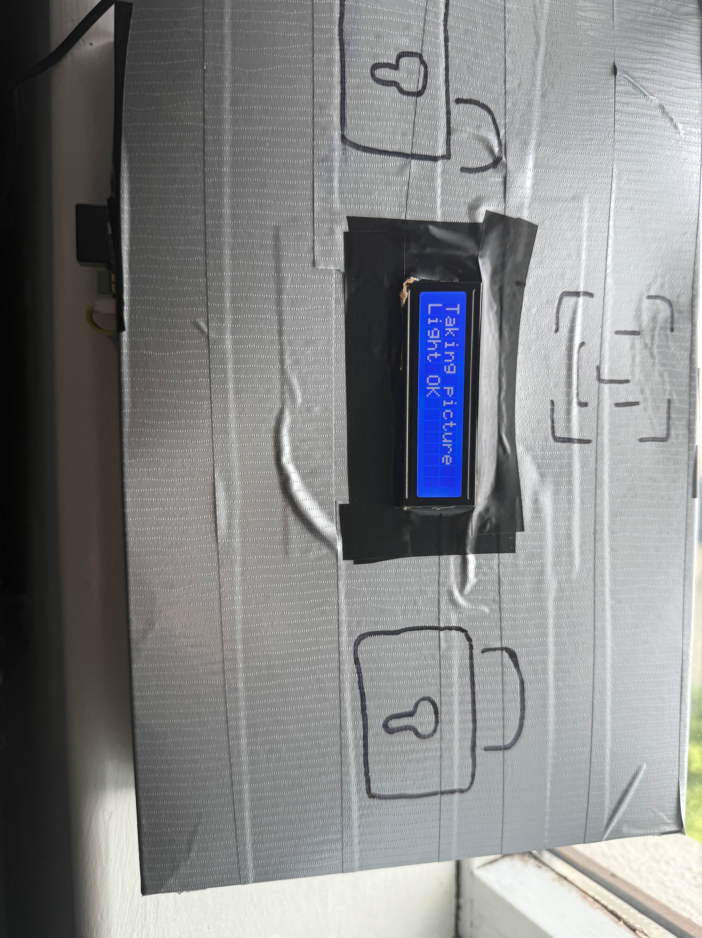
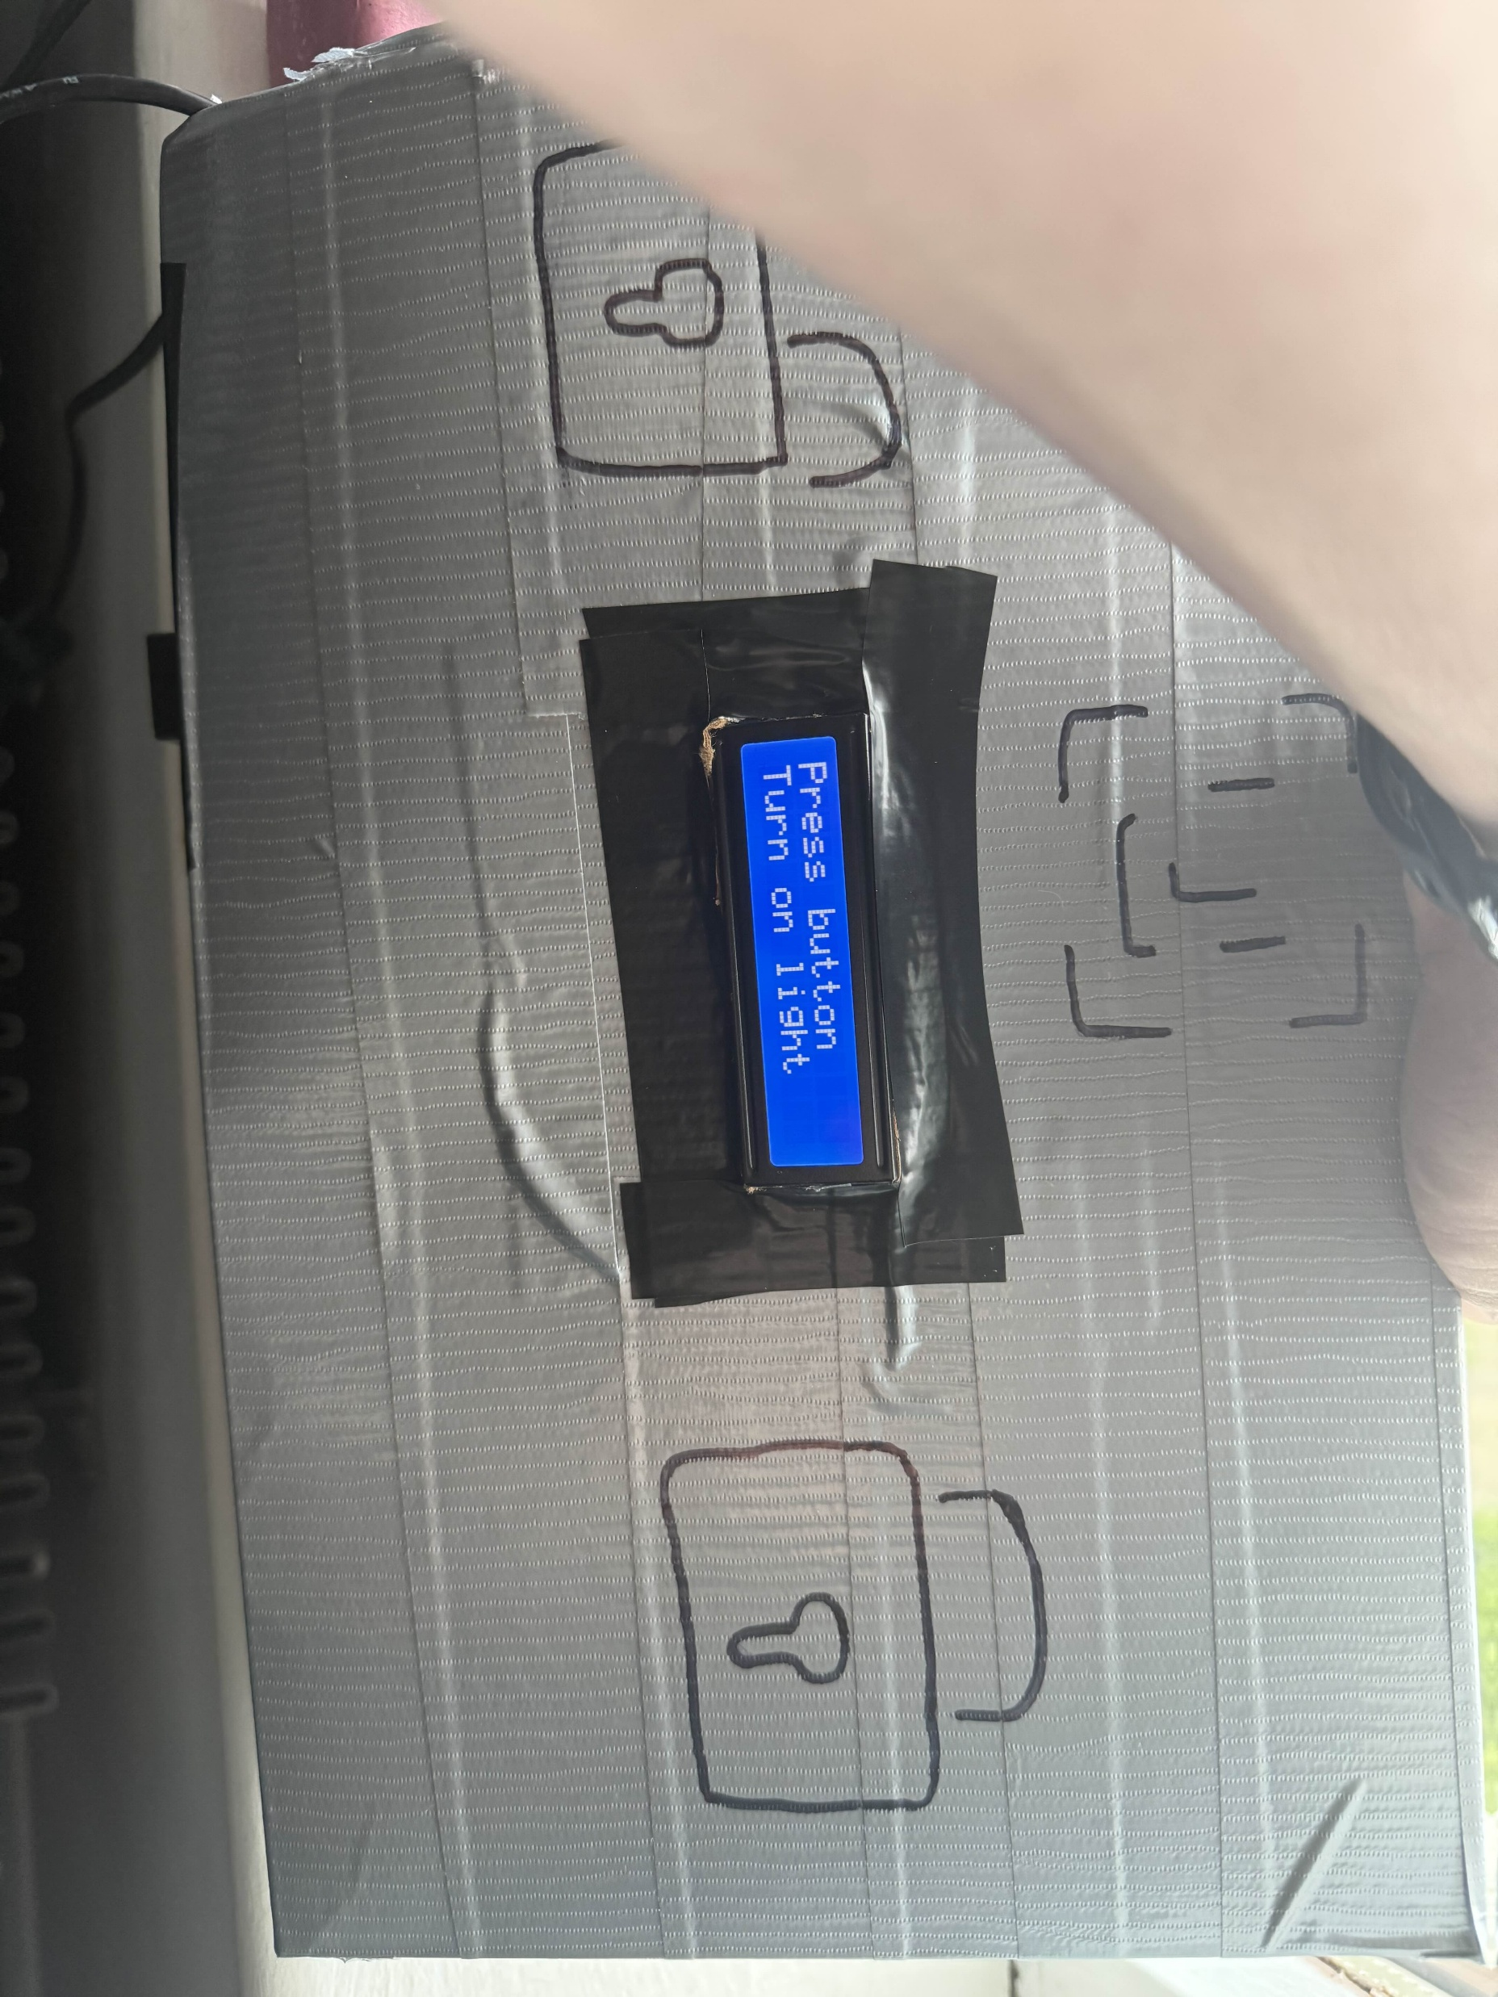

Some screenshots of what you can see
These are some of the outputs you can see on the screen and some of the stuff you can see on the raspberry pi terminal

Slide 4

Live Demo
Hopefully it goes well

Slide 5

Any Questions

